Slide 1
Major project
College Explorer portal
2003A52108 BHEEMREDDY DEVIKA
2003A52020 VANGARA SAIRAM
2003A52013 MOHAMMED IBRAHIM AFNAN AHMED
2003A52007 EPPAKAYALA RISHITH RAJ
2003A52018 THUMMA PAVAN KUMAR

Slide 2
Abstract
To create a seamless login interface tailored for students, facilitating the exchange of project codes, videos, and academic certificates. Drawing inspiration from the functionalities of LinkedIn, this platform enables users to engage in interactions such as liking and commenting on shared content. Through this innovative portal, students are empowered to showcase their academic endeavour, solicit feedback, and forge meaningful connections within their educational ecosystem. By amalgamating the features of a social network with academic collaboration tools, the project seeks to cultivate a vibrant community conducive to intellectual growth and collaborative learning.

Slide 3
Introduction
Introducing the College Explorer Portal, a cutting-edge platform revolutionizing education through seamless integration of technology. It offers students from varied backgrounds a centralized space to collaborate, showcase projects, and share educational materials. Bridging theory and practice, it empowers users to upload codes, videos, certificates, and more, enhancing learning and fostering a sense of achievement.

Slide 4
Problem Identification
In today's educational landscape, technology is key for dynamic learning. Introducing the College Explorer Portal, a pioneering platform where students collaborate, showcase projects, and bridge theory with practice. With user-friendly features, it empowers students to share codes, videos, certificates, and more, enriching their learning journey and fostering pride in their achievements.

Slide 5
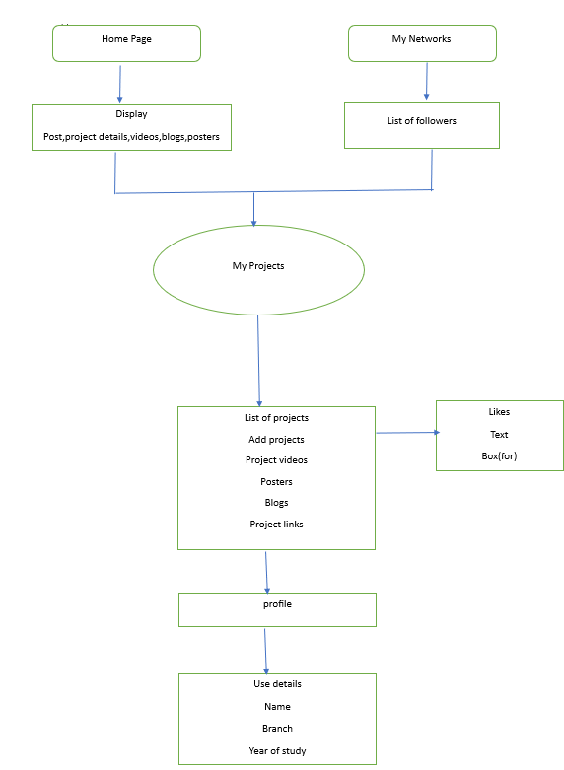
Architecture

Slide 6
Proposed Plan
The College Explorer Portal development will adhere to a structured methodology to ensure successful implementation of features, tackle challenges, and enhance user satisfaction. The approach includes key stages vital for platform development and deployment.

Slide 7
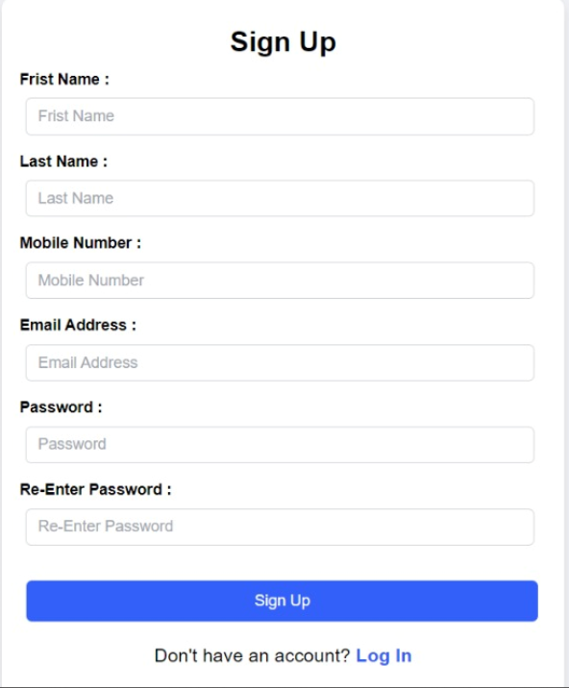
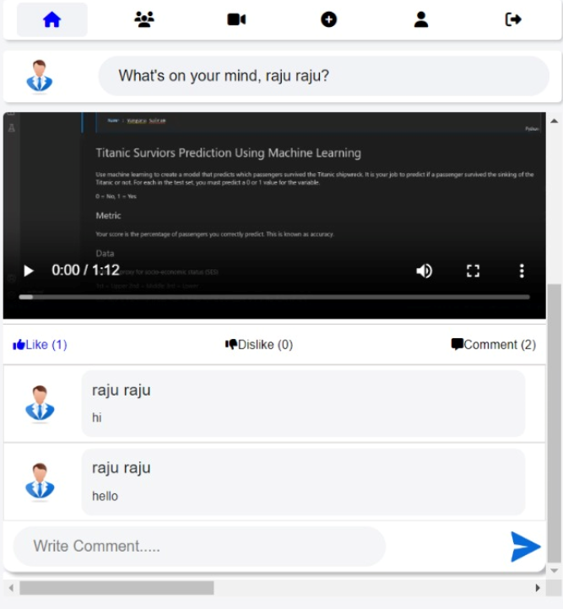
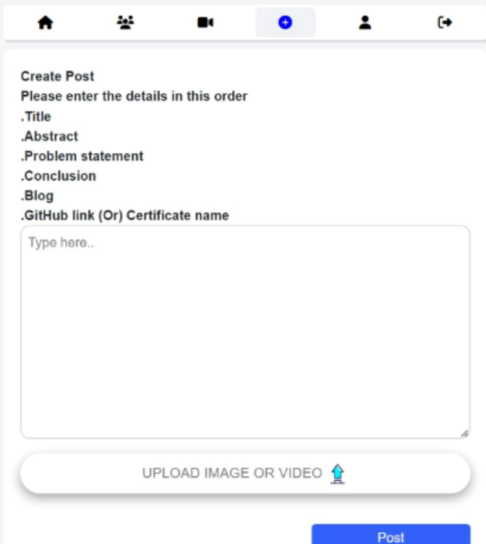
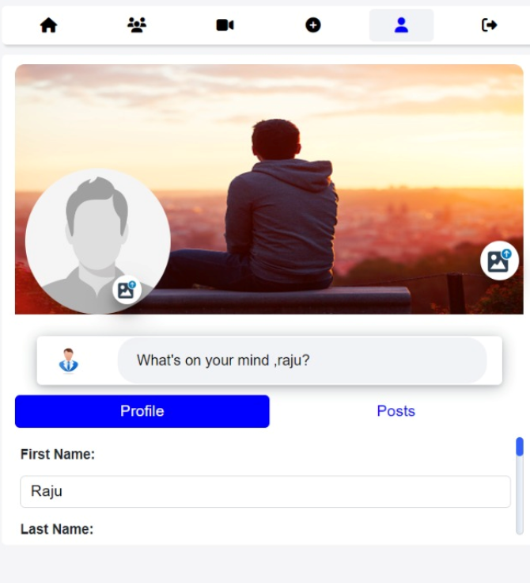
Result

Slide 8
conclusion
The College Explorer Portal is a groundbreaking tool fostering collaboration, engagement, and knowledge sharing in educational settings. By offering a central hub for project sharing and social interaction, it enables students to showcase their work, connect with peers, and develop crucial digital skills. Continuous refinement based on user feedback will keep the portal at the forefront of educational innovation.

Slide 9
Thank You

